Slide 1
PUBLIC INFORMATION MEETING ON THE PROPOSED BETHLEHEM TRANSFER STATION
June 5th, 2023
Bethlehem Town Hall
PREPARED BY BETHLEHEM TRANSFER STATION COMMITTEE

Slide 2
WELCOME AND THANK YOU FOR COMING
YOUR INPUT IS VERY IMPORTANT!
admin@bethlehemnh.org
Send us your IDEAS AND QUESTIONS

Slide 3
MISSION AND OBJECTIVES OF THE BETHLEHEM TRANSFER STATION COMMITTEE Established 2017
MISSION
To advise the Select Board on environmentally sound solutions and best practices for solid waste disposal and recycling management
OBJECTIVES
Plan the reopening of the Bethlehem Transfer Station
Recommend warrant articles for funding
Determine current regulatory rules
Establish timeline of implementation
Obtain solid waste service options
Consider all options
Take public input

Slide 4
WHY DO WE NEED A TRANSFER STATION?
State law requires towns to provide residents access to an approved solid waste facility.¹
After the NCES landfill closes within a few years, current trash collection and disposal services will cease.
The nearest landfill, Mt. Carberry, is 40 miles away.
New Hampshire towns largely rely on transfer stations for waste disposal and recycling, with 174 publicly-owned municipal facilities.²

Slide 5
Other Options Considered Before Recommending a Bethlehem Transfer Station
Use of a neighboring transfer station –
Short term solution of unknown availability and costs
Purchase or rental of existing NCES transfer station – Town already owns land with engineering plans
Curbside pickup by third party contractor – Too expensive!
Notes:
Unknown if another transfer station is willing and able to handle Bethlehem solid waste
Short term solution, subject to contracting and unknown costs at time of contract
A longer drive for Bethlehem residents to take their solid waste and recyclables
Hundreds of thousands of dollars of annual costs to Town budget
Short term solution, subject to contracting, with potentially high varying costs
Unknow if NCES is willing to sell or rent, and at what cost
Substantial construction and equipment would still be required to allow for compacting of waste and source-separation and baling of recyclables

Slide 6
A MODERN TRANSFER STATION IS NECESSARY
To protect our environment and economy (tourism)
To meet New Hampshire’s goal of reducing disposal of municipal solid waste (MSW) and construction and demolition debris (C&D) by 25% by 2030 and by 45% by 2050.³
To prevent wasteful spending
To protect our health

Slide 7
POOR WASTE MANAGEMENT AFFECTS OUR HEALTH
Plastic waste is:
In our lungs, bowels and blood
In our water, food, and air
In the breast milk of most healthy mothers⁴
Source: New York Times

Slide 8
BETHLEHEM’S PHASE I TRANSFER STATION WILL REDUCE COSTLY LANDFILLING BY:
Providing separate recycling stations and bins for cardboard, mixed paper, textiles, plastics, and metal and glass containers
Collecting food scraps for composting
Having a swap shop to exchange free items for reuse
Implementing a Pay-As-You-Throw system to reduce solid waste tonnage and taxpayer burden

Slide 9
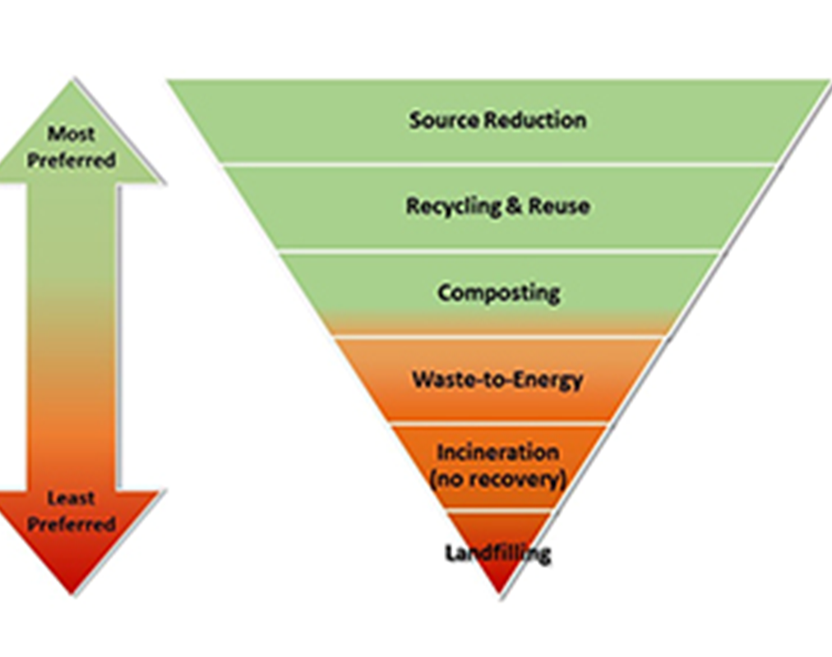
REDUCING, RECYCLING, AND REUSING CAN AVOID MOST LANDFILLING AND SAVE $$$
REDUCE AND REPURPOSE
Average U.S. household spends $1,866 per year on wasted food⁹. Food that cannot be stored or donated can be composted, not landfilled.
REDUCE, REUSE, AND RECYCLE
Average person buys 68 items of clothes per year, with 80% seldom worn¹⁰, and 85% ending up in landfills¹¹
REFUSE. REUSE.
Only 9% of plastic is recycled¹².

Slide 10
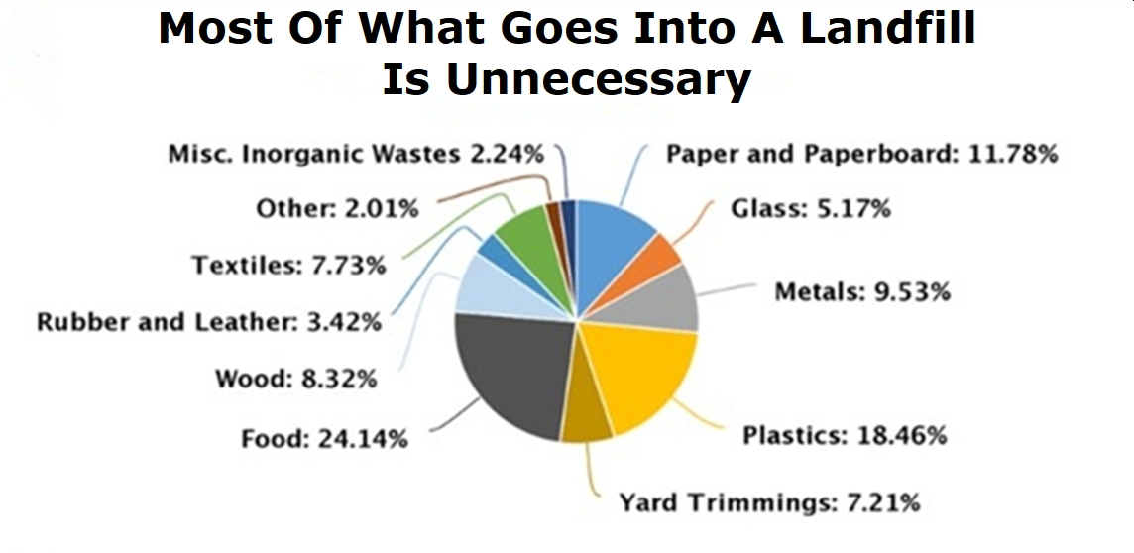

Slide 11
BENEFITS OF RETURNING TO SOURCE SEPARATION OF RECYCLABES
Processing and transportation fees for single-stream recycling can be $200 to $300 per ton with no recycling sale revenues for the town¹³.
Source separation of recyclables at a transfer station costs less, has less potential for contamination of loads sent to market, and provides revenues to offset costs.

Slide 12
BENEFITS OF A PAY-AS-YOU-THROW (PAYT) PROGRAM
Fairness – Residents control their own solid waste costs as we’ve done in the past
Tax Neutral – PAYT bag costs can be set to cover disposal costs for waste that needs to go to a landfill
Incentive-Based – Maximizes waste reduction and increases recycling and composting
Removes Free Riders – Eliminates incentive for non-residents to smuggle their waste into town for free disposal

Slide 14
REASONS FOR LOCATING THE TRANSFER STATION ON THE ROUTE 116 SITE
EASE OF REGULATORY APPROVAL
Previously used as a transfer station with regulatory approval
Existing paved entrance that received prior approved State driveway permit, with preliminary indication that a renewal of the permit will not be a problem

Slide 15
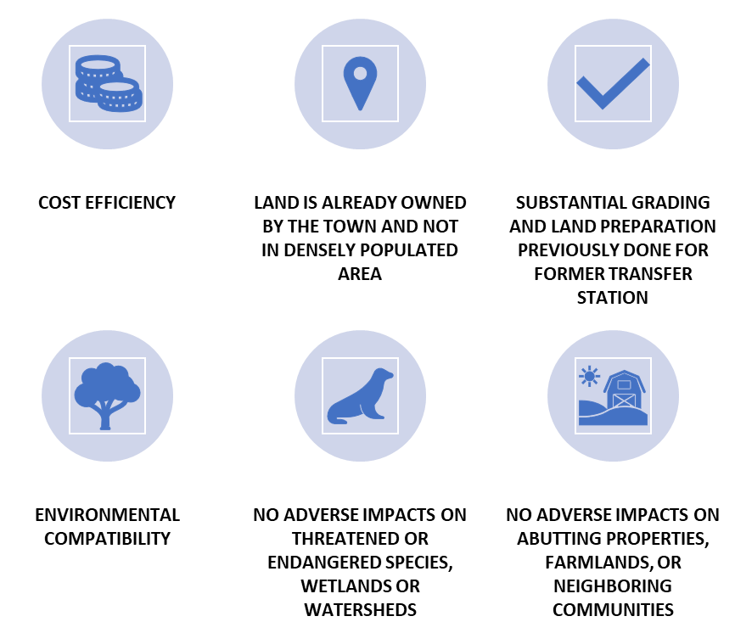
MORE REASONS…

Slide 16
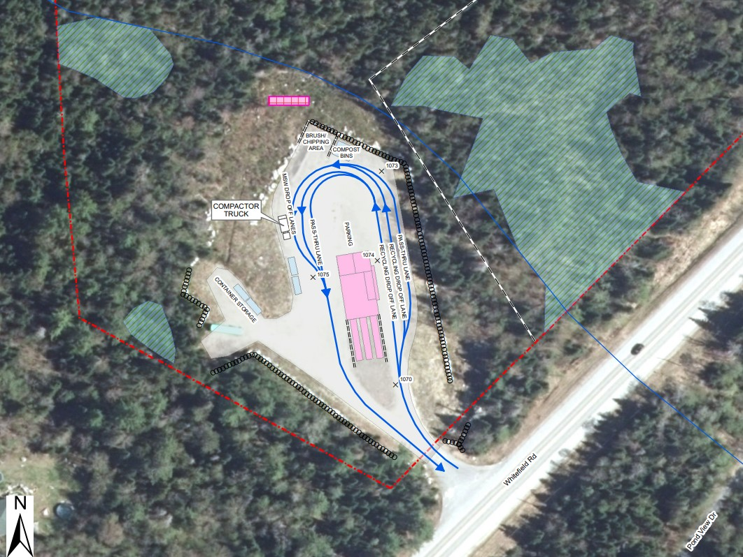

Slide 17
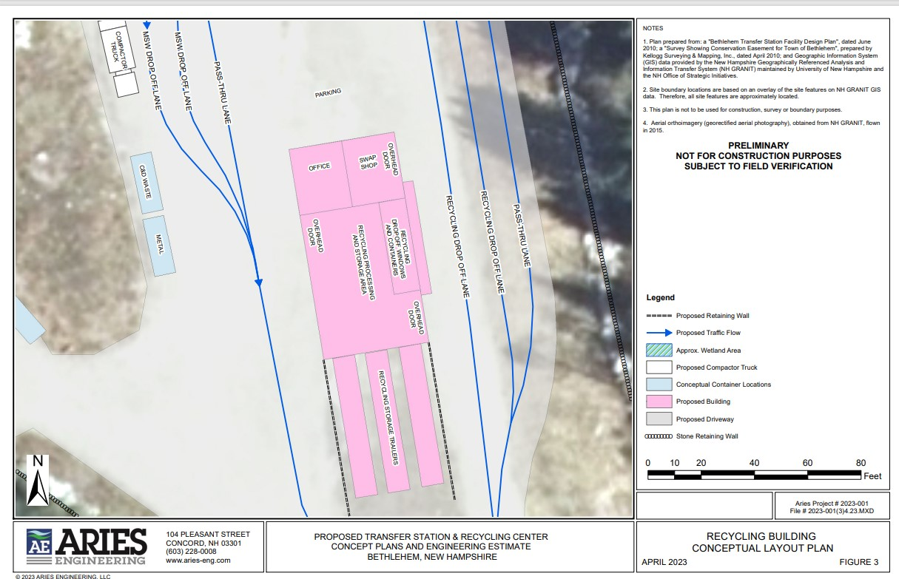

Slide 18
REASONS FOR PHASED APPROACH
PHASE 1 will provide a fully modern transfer station, while minimizing budgetary impact.
After opening and collecting data on operations, we can determine:
Whether further capital improvements, such as paving, additional equipment, or structures, are necessary or desirable.
If additional services, such as on-site composting, wood chipping, or tire shredding, are feasible and desirable.

Slide 19
POSSIBLE FINANCING OF THE TRANSFER STATION
U.S. Department of Agriculture Grant:
$309,984
Money Already in Capital Reserve Fund:
$244,000
Remaining funding to be determined by Select Board, possibly over several years to minimize budget impact:
$331,684
The Town will continue to seek additional grants to reduce costs to taxpayers.

Slide 20
PHASE 1 COST ESTIMATE
Before USDA Grant Funding Applied
Development and Construction $ 422,173
Land and Rights $ 0
Architect/Engineer $ 86,000
Equipment/Furniture $ 296,380
Contingency (10%) $ 81,115
TOTAL $ 885,668
USDA grant requirement - all equipment and material must be made in the USA

Slide 21
POSSIBLE WAYS TO FINANCE NON-GRANT PORTION
NOTE: This is a decision to be made by the Select Board and voters. Public input is welcomed and considered vital to a successful completion of this project!
Some goals for consideration are:
No borrowing, to preserve this option for other capital projects.
Less than 3% impact on the Town’s municipal budget
Gives time to seek other grants

Slide 22
PROJECTED OPERATING BUDGET
The Select Board has yet to consider a budget.
An estimated first year operating budget is $193,0000. Estimated revenues are $119,000. Net budget impact: $74,000.
PAYT bag costs priced to cover transportation and tipping fee costs
Fees for special waste services (e.g., tires, appliances, construction debris, etc.) covering their costs
Notes:
Despite a review of neighboring transfer station budgets, and past town solid waste data, predicting the costs, revenues, and resale markets for a new, future system is difficult. Thus, a conservative, first year operation budget has $193,095 in expenses and $119,000 in revenues, based on:
PAYT bag costs priced to cover transportation and tipping fee costs
Fees for special waste services (e.g., tires, appliances, construction debris, etc.) covering their costs
No charge for routine residential recyclables, and assuming low/moderate resale revenue

Slide 23
Bethlehem will strive to be the best!
Neighboring towns and other rural communities have done this with PAYT and source-separated recyclables.
We will develop plans to assist persons with disabilities in transporting their waste and recyclables through neighbors helping neighbors.
We will encourage donations of PAYT bags to our pantries to help low-income persons and families.

Slide 24
Send us further questions that you may have.
Let us know if you desire to see the plans and documents submitted to the USDA for our grant application.
Give us your ideas to further our goal to have a cost-efficient, environmentally friendly transfer station that will enhance our economy.
Email us at admin@bethlehemnh.org

Slide 25
REFERENCES
RSA 149-M:17.
(2) New Hampshire Department of Environmental Services (NHDES). New Hampshire Solid Waste Management Plan. September 30, 2022. Page 5. The Plan may be accessed at https://www.des.nh.gov/sites/g/files/ehbemt341/files/documents/r-wmd-22-03.pdf.
(3) Id., P. 2.
(4) O’Connell M. Our Way of Life Is Poisoning Us. The New York Times. April 23, 2023.

Slide 26
REFERENCES (continued)
(5) RSA 149-M:3.
(6) NHDES, supra, P. 2.
(7) U.S. Environmental Protection Agency. Basic Information about Landfill Gas. Last Updated April 21, 2023 at Basic Information about Landfill Gas | US EPA.
(8) Crunden E. Toxic PFAS waste that lasts ‘forever’ poses financial, logistical challenges for landfills. WasteDive. October 19, 2020, accessed at Toxic PFAS waste that lasts 'forever' poses financial, logistical challenges for landfills | Waste Dive.

Slide 27
REFERENCES (continued)
(9) Gill C. The Average American Household Wastes $1,866 of Food Per Year. Futurity. January 23, 2020. The average American household wastes $1,866 of food per year – Futurity.
(10) Berge E. How many clothing items does the average person buy a year? (2023). Fashioncoached. Last updated on January 18, 2023 at How many clothing items does the average person buy a year? (2023) (ngontinh24.com).
(11) Igin M. 10 Concerning Fast Fashion Waste Statistics. Earth.org. August 2, 2022, at 10 Concerning Fast Fashion Waste Statistics | Earth.Org

Slide 28
REFERENCES (continued)
(12) 9 Percent ofPlastic Worldwide is Recycled, OECD Says. VoaNews. February 23, 2022 at 9 Percent of Plastic Worldwide is Recycled, OECD Says (voanews.com).
(13) In its October 25, 2022 Full of Scrap Newsletter, the Northeast Resource Recovery Association (NRRA) noted that one of its member communities in southern New Hampshire was “...shocked to learn that their ... costs for curbside single stream recycling is now one third more than their cost to dispose of trash.” An NRRA representative informed a member of the Transfer Station Committee in late October that the then current processing fee for a delivered ton of single-stream recyclables with glass at one Massachusetts processing facility is $194.50. This is over and above the collection and transportation costs to that facility.

Slide 29
REFERENCES (continued)
(14) NHDES, supra, P. 31.

