Slide 1
Bethlehem, Franconia, and Sugar Hill Community Power
Public Hearing: Electric Aggregation Plan
12/7/2023, 6 pm
Profile School Library
Notes:
This presentation will cover (1) what is Community Power; (2) the details of the draft Electric Aggregation Plan; and (3) questions and discussion.

Slide 2
What is Community Power?
New Hampshire cities, towns, and counties can become default electricity provider for their residents + businesses and provide related services.
Pooled Purchasing Power
for Energy Supply
Utility Company
Delivers Power
Communities Benefit from Value Added Services & Programs
Lower Rates & Product Choices
Economies of Scale
Grid Reliability
RSA 53-E, Relative to Aggregation of Electric Customers by Municipalities & Counties
Customers may switch back to utility default supply or take service from a Competitive Supplier
Community Power programs must be paid for out of revenues received from participating customers

Slide 3
Goals & Objectives of Community Power
Local
Control
Lower
Costs
Clean
Energy
Resilience & Innovation
Democratizing energy procurement to the community level
Demonstrated lower rates than regulated utilities
Build and buy clean energy
Support more local renewables
New technologies
Market competition
Price signals
Customer empowerment
“Community Power will only launch if it is able to initially offer residential default rates that are lower than those offered by Eversource.”
(Page 2 of proposed Electric Aggregation Plan)

Slide 4
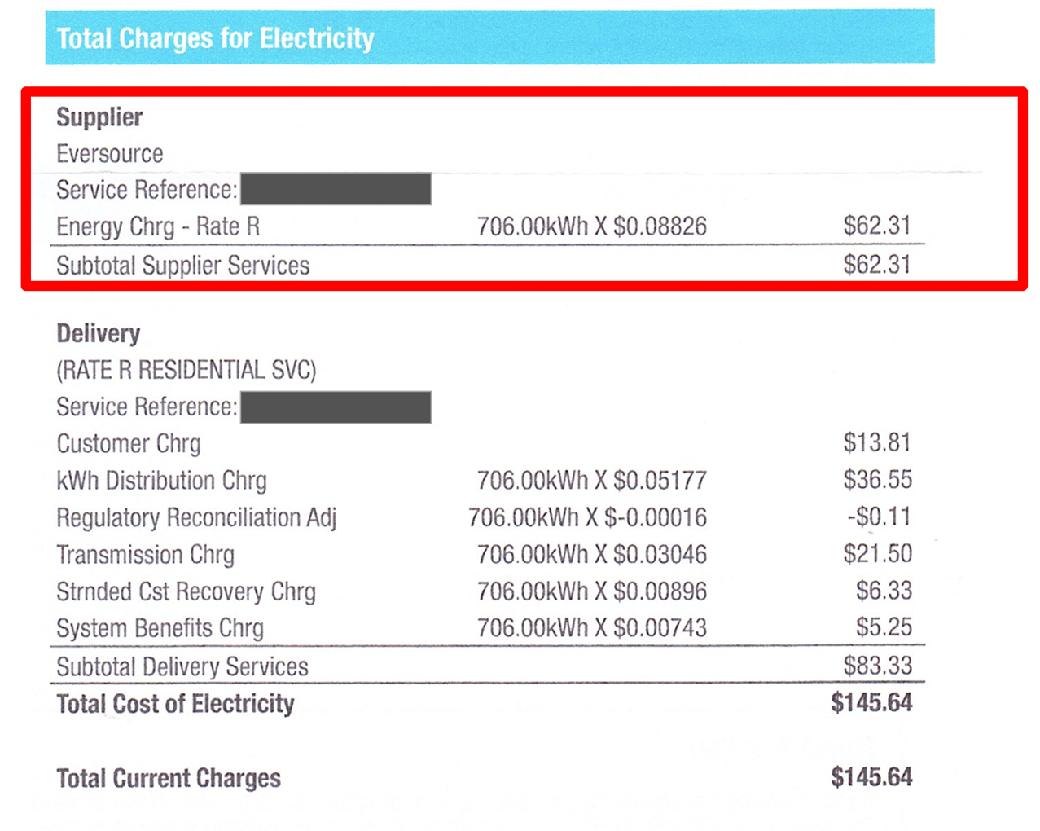
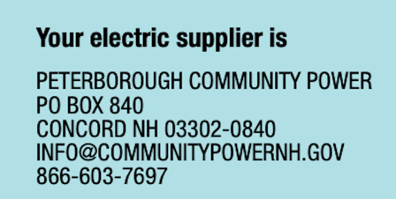
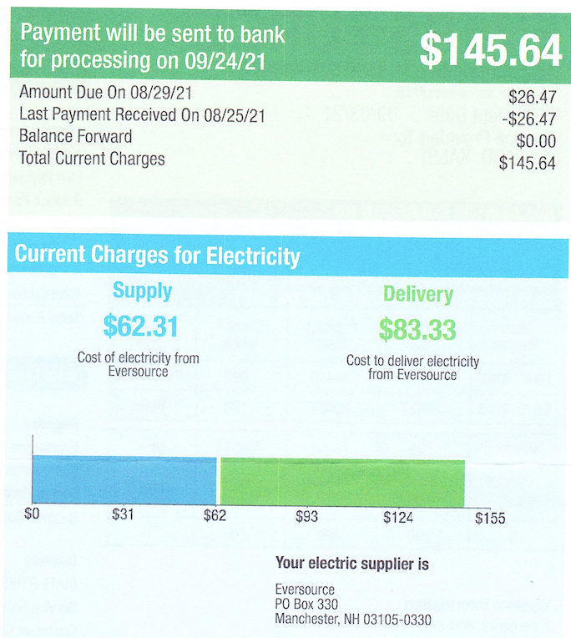
Eversource
Electric Bill:
Supply & Delivery
706.00kWh X $0.109 $76.95
$160.28
$160.28

Slide 5
Approval & Implementation Processes
Form Committee 🡪 Research & Planning 🡪 Town Meeting 🡪 Launch!
1. Form Committee & Join Coalition “Joint Powers Agency”
Select Board established Committee to explore Community Power
Select Board voted to join CPCNH
2. Community Power Committee | Research & Planning
Committee drafts “Electric Aggregation Plan” (EAP)
2 Public hearings to collect community input
3. Town Meeting Adopts EAP
Town Meeting adoption of EAP authorizes (but does not require) the Select Board to contract for services to launch & operate Community Power.
4. Launch!

Slide 6
Sample Warrant Article
“To see if the Town will vote to adopt the [MUNI] Community Power plan, to authorize the Select Board to implement the plan, and to take all action in furtherance thereof, pursuant to RSA 53-E. The [MUNI] Community Power plan is an opt-out program that offers more flexible electricity procurement. The plan will initially provide lower electricity rates for residents, or it will not launch. Initial participation in the plan can be declined, after which enrollment becomes voluntary.”
Tax Impact: None
Select Board Vote:

Slide 7
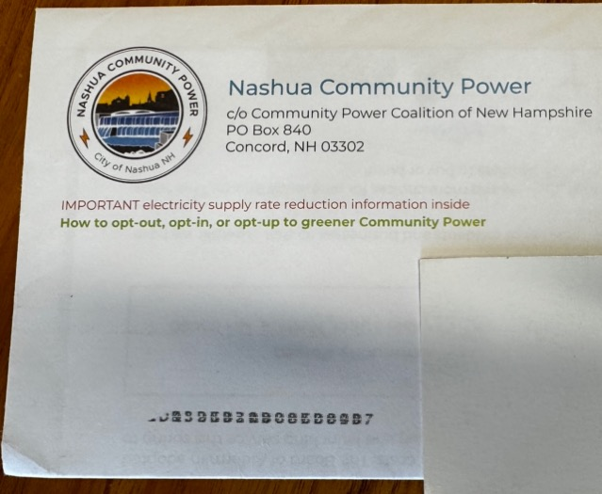
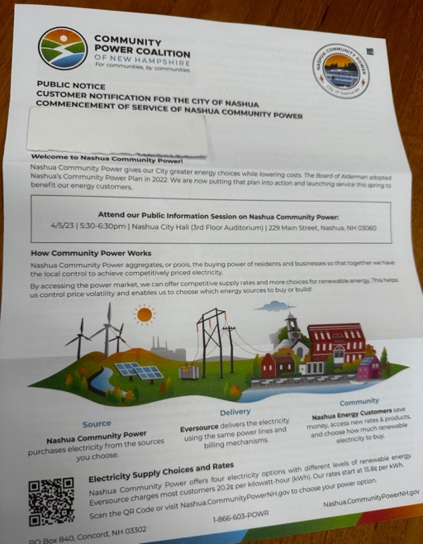
Customer Notification and Enrollment Process
At least 30 days before program launch all electric customers will be mailed notifications including the initial fixed rate for Community Power service compared with the local utility
Customers on Eversource default energy service able to decline participation or “opt-out” by calling 1-866-603-POWR, contacting info@CommunityPowerNH.gov ; or visiting www.CommunityPowerNH.gov
If a customer is already getting their power from a competitive supplier, nothing will change unless they choose to “opt-in” to Community Power.
Eversource will continue to deliver electricity using their poles and wires, provide billing services, and ensure reliability.
Rates posted at least 30 days in advance; customers can switch supplier at next meter read upon request with no penalty or exit fee.
Community Power is self-funded by rates paid by participating customers. No taxes will be used to cover program expenses.

Slide 8
What is the Electric Aggregation Plan?
Select Boards established Committees pursuant to RSA 53-E to oversee development of the Electric Aggregation Plans (EAP).
EAP details how the Community Power program will operate and comply with state legal requirements.
There will be two Public Hearings on 12/7/2023, 12/14/2023, and 12/18/2023 (Sugar Hill only) to educate the Community about the Plan and to receive community input.

Slide 9
Purpose of the Electric Aggregation Plan
Defines program goals and objectives
Defines governance; implementation; customer noticing, enrollment, options
Commits municipality to comply with applicable statutes and regulations:
(a) Providing universal access, reliability, and equitable treatment of all classes of customers;
(b) Meeting, at a minimum, the basic environmental and service standards established by the Public Utilities Commission and other applicable agencies and laws and rules.
The Plan does:
Address issues required to be considered by RSA 53-E including:
How net metering will be provided;
How customers enrolled in the Electric Assistance Program will receive their discount.
The Plan does not:
Otherwise commit the town to any defined course of action; or
Impose any financial commitment or liability on the town or its taxpayers.

Slide 10
Electric Aggregation Plan Outline
Chapters:
1. Introduction
2. Overview of Community Power
Customer Notification & Enrollment
# of Accounts & Electricity Usage Estimates
Membership with CPCNH
Purpose of the Plan
Approval, Implementation Process, PUC Review
3. Goals & Objectives
4. Statutory Requirements
A. Organizational Structure of Program
B. Entering into & Terminating Agreements
C. Operation and Funding
D. Rate Setting, Costs, Enrollment, Options
E. Rights and Responsibilities of Participants
F. Net Metering & Group Net Metering
G. Electric Assistance Program
H. Termination of Program
Draft EAP available for review at:
https://bethlehemnh.org
http://www.franconianh.org
https://www.sugarhillnh.org
Appendices:
CPCNH
Net Metering
Load Serving Entity Services
Customer Data Protection Plan
Abbreviations

Slide 11
Customer Accounts & Usage Estimates
[INSERT 2203.02 Data Table if available]

Slide 12
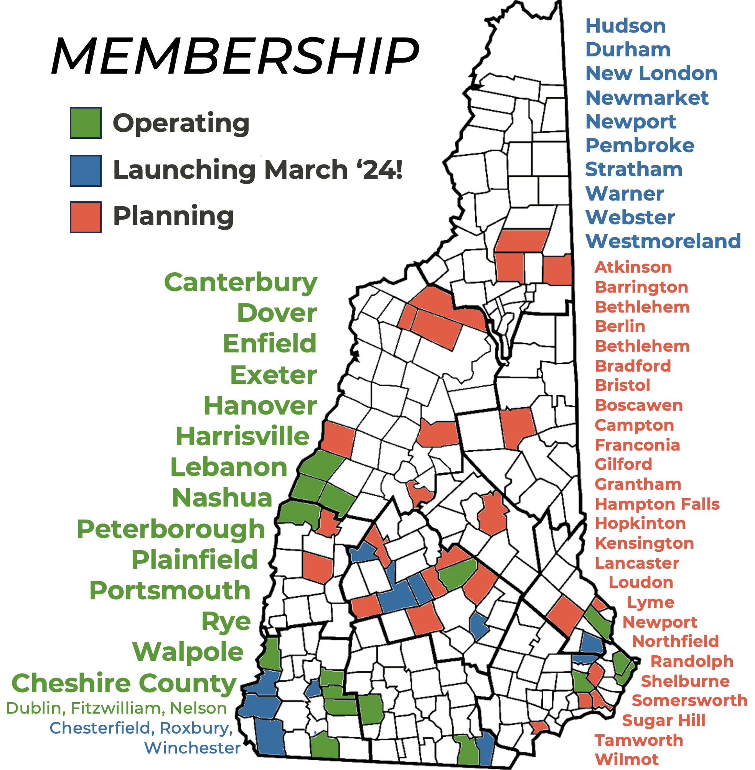
Community Power Coalition of NH
Community-governed, nonprofit power supplier
Our Mission
To foster resilient New Hampshire communities by empowering them to realize their energy goals.
Formed 10/1/21 by 14 cities, towns, counties
50 Members | >25% of NH population
14 Members launched 2023
~80,000 customers
~400,000 MWh in 2023 (APR – DEC)
~$51 million 2023 revenues (controlled by communities)
Remaining & new Members to launch 2024+
All NH cities & towns are invited to join

Slide 13
Board of Directors
Community Governance
Staff & Service Providers
Expert Operations
Technical Expertise | Transparent & Accountable Accelerate Energy Transition | Public Advocacy
Board Committees
Audit
Executive
Finance
Governance
Member Outreach & Engagement
Regulatory & Legislative Affairs
Risk Management
CEO
Brian Callnan
Staff:
Administration
Member Services
Load & Power Resources
Regulatory & Legislative Affairs
Energy Portfolio Risk Mgmt.
Retail Customer Services & Data Mgmt.
Legal
Accounting
Banking
Community Engagement
Local elected officials, former utility executives, energy finance & development professionals, municipal managers, teachers, & much more.
Notes:
The key to the success of the Coalition Model is a combination of (1) Community Governance; and (2) Expert Staff & Service Providers on the operations side of the business.
We have a Board of 20 community representatives, elected by and from our Member cities and towns. These are local elected officials, municipal managers, and community leaders — many of whom have deep expertise and experience in the power sector. Our Board includes former utility executives, legislators and regulators, founders of energy companies — all providing oversight and ensuring we serve the interests of our communities.

Slide 14
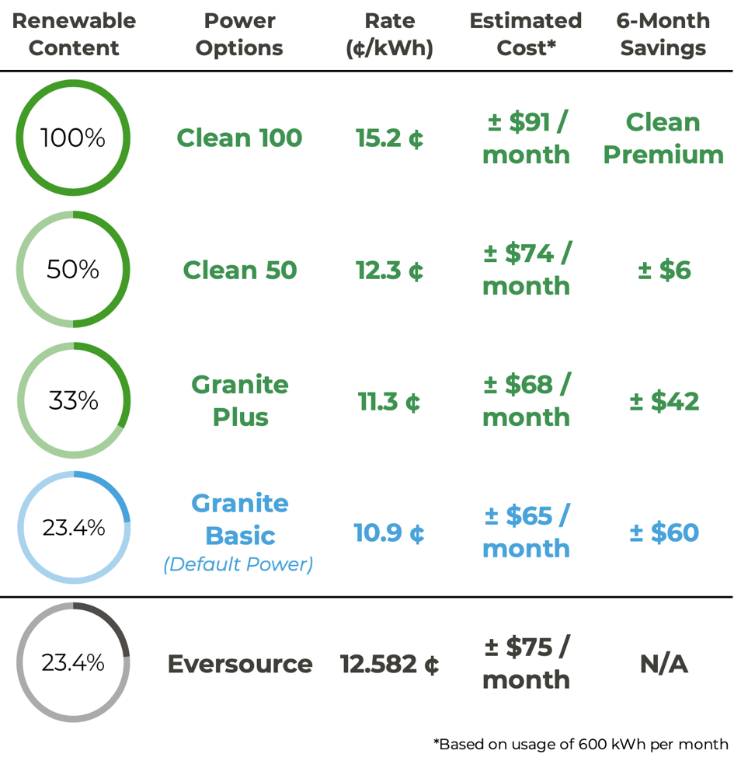
Electricity Choices
Aug 1, 2023 – Jan 31, 2024
Energy customers can select from a menu of energy choices by:
Visiting www.CommunityPowerNH.gov and using the portal, or calling 1-866-603-POWR, to select their power option.
Please have your utility account number handy so your selection may be easily processed.
Customers are always free to choose to buy power from their utility, or from another market option, without charge.

Slide 15
Key Points
If/when Your Community Power launches, most Eversource default electric supply customers will be automatically enrolled in the same service for a lower price. Community Power will be the new default electricity supplier for your Town’s customers.
Participation in Community Power is voluntary. Customers can choose to opt-out and to stay with Eversource for electric supply, or shop for another market option.
Eversource will continue to deliver electricity using their poles and wires, provide billing services, and ensure reliability.
Customers shopping with third-party suppliers will remain with their supplier unless they choose to opt-in to Community Power.
Community Power will be self-funded by rates paid by participating customers. No taxes will be used to cover program expenses.

Slide 16
INSERT LOGO OR TOWN SEAL
Questions & Answers
www.cpcnh.org
CommunityPowerNH.gov

